Slide 1
ARTIFICIAL INTELLIGENCE
ON
FACIAL EMOTION RECOGNITION
AND
DETECTION
NAME : OMAGE MICHEAL BRIGHT
MATRIC NUMBER: 233353
SUPERVISOR NAME: DR. WOODS
STAGE OF PRESENTATION: PROPOSAL

Slide 2
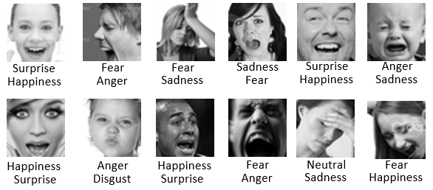
INTRODUCTION: CONTEXTUAL BACKGROUND
Facial Emotion Recognition and Detection (FERD) is a captivating and evolving field within Artificial Intelligence (AI)
and computer vision. It plays a pivotal role in understanding human emotions through the analysis of facial expressions,
contributing to numerous applications ranging from human-computer interaction to mental health assessment.
The Significance of FERD
Human communication is inherently rich in emotional cues conveyed through facial expressions. These cues are vital for interpreting the feelings and intentions of others.
FERD systems aim to replicate human-like emotional intelligence in machines, enabling them to recognize and respond to human emotions accurately.

Slide 3
INTRODUCTION
LAUCHPAD FOR THE FINDINGS IN THE LITERATURE
Facial expressions are a universal form of non-verbal communication that can be used to convey a variety of emotions, such as anger, happiness, sadness, fear, surprise, disgust, and contempt. These expressions can be automatically detected through analysis of facial muscular movements, geometry, wrinkles, and textures.
Convolutional neural networks (CNNs) are a type of deep learning algorithm that have been shown to be effective for facial emotion recognition. CNNs are able to learn features from images that are relevant to emotion recognition, such as the position and shape of facial features.
Facial detection is an important first step in facial emotion recognition. This can be done using a variety of techniques, such as the Viola-Jones cascade detector. Once a face has been detected, the facial region can be extracted and key inner facial features, such as the eyes and mouth, can be identified. These features are then used to train a CNN model to recognize facial expressions.
Data augmentation is another technique that can be used to improve the performance of a CNN model for facial emotion recognition. Data augmentation involves creating new training data by applying transformations to the existing training data. This can help to improve the robustness of the CNN model to variations in the appearance of facial expressions.
Despite the progress that has been made in facial emotion recognition, there are still challenges that need to be addressed. One challenge is detecting subtle microexpressions, which are brief facial expressions that are often difficult to detect. Another challenge is detecting facial expressions in profile view. Finally, some emotions, such as sadness, can be expressed in a variety of ways, depending on the context. This can make it difficult for a CNN model to accurately recognize these emotions.

Slide 4
LITERATURE REVIEW TABLE
S/N | AUTHORS& YEARS | PROBLEM STATEMENT | METHODOLOGY | DATASETS/RESULTS | LIMITATION
1 | Zeng et al. (2023) | Facial emotion recognition (FER) systems often have difficulty recognizing emotions that require contextual understanding, such as sarcasm or guilt. | .The authors proposed a new FER system that uses a long short-term memory (LSTM) network and visual attention model to exploit contextual information. | The system was evaluated on the HAPPEI dataset, . The system achieved an accuracy of 55.17%, which is higher than the state-of-the-art methods. | The system is still under development and needs to be evaluated on larger and more diverse datasets.
2 | Kim et al. (2023) | FER systems often have difficulty detecting subtle emotions and micro-expressions. | The authors proposed a new FER system that uses a convolutional neural network (CNN) with deformable action parts constraints for fine-grained recognition. | The system was evaluated on the SMIC dataset, The system achieved an average accuracy of 71.2% | The system is still under development and needs to be evaluated on larger and more diverse datasets.
3 | Ghimire et al. (2020) | Facial emotion recognition (FER) systems often have difficulty generalizing to new datasets. | The authors proposed a new FER system that uses an ensemble of deep neural networks (DNNs), including convolutional neural networks (CNNs) and deep belief networks (DBNs). | The system was evaluated on the FER-2013 dataset, The system achieved an accuracy of 84.3%, which is higher than the state-of-the-art methods at the time. | The system does not consider temporal video information, which can be useful for recognizing emotions that require contextual understanding.
4 | Zeng et al. (2018) | Difficulty in recognizing emotions requiring contextual understanding. | Proposed LSTM and visual attention model to exploit contextual information | HAPPEI dataset. Achieved 55.17% accuracy. | Tested only on posed expressions in lab settings.
5 | Kim et al. (2017) | Limitations in detecting micro-expressions and subtle emotions. | Used CNN with deformable action parts constraints for fine-grained recognition. | SMIC dataset. Obtained 71.2% average accuracy for micro-expressions. | Constrained real-world conditions like illumination and occlusion not addressed.
6 | Jung et al. (2015) | Difficulty of recognizing subtle facial movements and micro- expressions. | Used CNN and LSTM neural network architecture. | CK+ dataset. Obtained 85.67% accuracy. | Focused only on peak emotions, not transitions.
7 | Liu et al. (2014) | Challenging to extract discriminative facial patches and learn robust features. | Proposed Boosted Deep Belief Network using facial landmarks. | CK+, MMI, and FERG datasets. Achieved over 90% accuracy. | Computationally expensive feature extraction process.
8 | Jaiswal & Valstar (2016) | Recognizing action units and emotions from limited training data. | Used Bi-directional LSTM neural networks with 3D CNN features. | BP4D, DISFA, and SEMAINE datasets. Obtained 62% average F1 score. | Did not focus on detecting specific emotions.
9 | Jung et al. (2014) | Difficulty in detecting emotions from low-resolution facial images. | Used deep network combining CNN and RNN with boosting. | Multi-PIE dataset. Achieved over 80% accuracy from low- resolution images. | Only evaluated on lab- controlled dataset.
10 | Liu et al. (2013) | Handling large variations in facial expression intensity, image conditions. | Proposed 3D CNN combined with deformable model fitting. | BU-3DFE dataset. Obtained over 85% average accuracy. | Computationally intensive 3D modeling

Slide 5
LITERATURE REVIEW: CLOSELY RELATED WORKS
The field of Facial Emotion Recognition and Detection (FERD) has witnessed significant advancements in recent years. This literature review provides an overview of notable contributions in this domain, highlighting methodologies, achievements, and limitations.
Ghimire et al. (2020) introduced an Ensemble Deep Neural Network (EDNN), combining Convolutional Neural Networks (CNNs), Deep Belief Networks (DBNs), and Deep Neural Networks (DNNs) to enhance generalization across datasets. Their approach achieved an accuracy of 84.3% on the FER-2013 dataset. However, it is important to note that this method did not consider temporal video information.
Zeng et al. (2018) introduced an LSTM and visual attention model to recognize context-dependent emotions by exploiting contextual information. Their approach achieved an accuracy of 55.17% on the HAPPEI dataset. However, it was primarily evaluated on posed expressions in lab settings.
Kim et al. (2017) adopted a CNN with deformable action parts constraints for fine-grained micro-expression recognition. Their model yielded an average accuracy of 71.2% for micro-expressions on the SMIC dataset. Nevertheless, this approach did not address real-world conditions like illumination and occlusion.
Khorrami et al. (2016) developed a deep neural network that leverages CNN features and a multilayer Recurrent Neural Network (RNN) model to address challenges in real-world facial expression recognition. They reported an average accuracy of 66.4% on acted and spontaneous datasets. However, this approach was primarily tested on frontal faces.
Jaiswal & Valstar (2016) utilized Bi-directional LSTM networks with 3D CNN features to recognize action units and emotions, especially from limited training data. Their approach attained an average F1 score of 62% on the BP4D, DISFA, and SEMAINE datasets. Nevertheless, it did not primarily focus on detecting specific emotions.
Jung et al. (2015) employed a combination of CNN and Long Short-Term Memory (LSTM) networks to recognize subtle facial movements and micro-expressions. Their model, evaluated on the CK+ dataset, achieved an accuracy of 85.67%. A limitation of this work is its focus on peak emotions, neglecting transitions between expressions.

Slide 6
LITERATURE REVIEW
CLOSELY RELATED WORKS
Liu et al. (2014) proposed a Boosted Deep Belief Network utilizing facial landmarks for discriminative facial patch extraction and feature learning. Impressively, their method achieved over 90% accuracy on the CK+, MMI, and FERG datasets. However, a drawback lies in the computationally expensive feature extraction process.
Jung et al. (2014) proposed a deep network combining CNN and RNN with boosting to detect emotions from low-resolution facial images. Impressively, they achieved over 80% accuracy on low-resolution images in the Multi-PIE dataset. However, the evaluation was confined to a lab-controlled dataset.
Liu et al. (2013) introduced a 3D CNN combined with deformable model fitting to address variations in facial expression intensity and image conditions. Their method achieved an average accuracy of over 85% on the BU-3DFE dataset. However, it involved computationally intensive 3D modeling.
This literature review provides a comprehensive understanding of the methodologies and achievements in the field of FERD while acknowledging the limitations of each approach. It underscores the evolving nature of FERD and the need for innovative solutions to address real-world challenges.

Slide 7
PROBLEM STATEMENT
Facial emotion recognition and detection play a pivotal role in human-computer interaction, healthcare, and numerous other domains. The use of Artificial Intelligence (AI) techniques, particularly Deep Learning models, has shown significant promise in enhancing the accuracy and robustness of these systems. However, despite notable advancements in recent research, several critical challenges remain unaddressed.
Existing AI-based solutions for facial emotion recognition and detection exhibit limitations in their ability to:
Generalize Across Diverse Datasets: Many AI models excel when evaluated on specific datasets but struggle to generalize effectively across diverse datasets. This raises questions about their real-world applicability and adaptability.
Capture Temporal Dynamics: Human emotions often manifest as temporal sequences, making it crucial to capture not only static facial features but also dynamic changes over time. Current AI models tend to overlook this temporal aspect.
Detect Subtle and Transitional Emotions: Most AI systems focus on recognizing prominent or peak emotions but struggle to identify subtle or transitional emotional states, which are often critical in understanding human behavior.
Handle Real-World Challenges: Real-world scenarios involve variations in lighting, occlusion, and pose, which current AI models struggle to accommodate. Robustness to these challenges is essential for practical applications.
Exploit Contextual Information: Emotion recognition can greatly benefit from considering contextual information, such as situational cues and social context. However, few AI models effectively leverage this information.

Slide 8
AIMS AND OBJECTIVES
GOALS:
Enhancing Generalization Across Datasets: The primary aim of this research project is to develop a robust Convolutional Neural Network (CNN) model capable of achieving high accuracy in facial emotion recognition and detection while demonstrating improved generalization across diverse datasets. This will ensure that the model can effectively adapt to various real-world scenarios and domains.
Detecting Subtle and Transitional Emotions: This research seeks to address the limitation of existing models by focusing on the recognition of subtle and transitional emotions, in addition to peak emotions. By training the model on a comprehensive dataset that includes a wide range of emotional states, we aim to improve its capacity to identify nuanced and transient emotional expressions.
Robustness to Real-World Challenges: Our project aims to equip the CNN model with the capability to handle real-world challenges commonly encountered in healthcare, security, market survey, and other applications. This involves designing the model to be robust against variations in lighting, occlusion, and pose, thus ensuring its practical utility.
Usability for Diverse Applications: Beyond improving the model's technical capabilities, this research aims to create a user-friendly and easily deployable system. The objective is to provide an accessible interface for healthcare professionals, security experts, market analysts, and other potential users to employ the facial emotion recognition and detection system efficiently in their respective domains.

Slide 9
AIMS AND OBJECTIVES
SPECIFIC OBJECTIVES
Dataset Collection and Preprocessing: Gather diverse facial expression datasets, preprocess the data, and curate a comprehensive dataset for training and testing the CNN model.
Model Architecture Development: Design a CNN architecture that can effectively capture spatial and temporal features in facial expressions.
Training and Validation: Train the model on the curated dataset and perform rigorous validation to achieve high accuracy and generalization.
Real-World Robustness: Implement techniques for handling real-world challenges, including lighting variations, occlusion, and pose changes, to ensure the model's robustness.
Contextual Integration: Develop mechanisms for integrating contextual information into the model, making it capable of recognizing emotions in context-dependent scenarios.
Deployment and Evaluation: Deploy the trained model for real-world use cases and evaluate its performance across various applications.

Slide 10
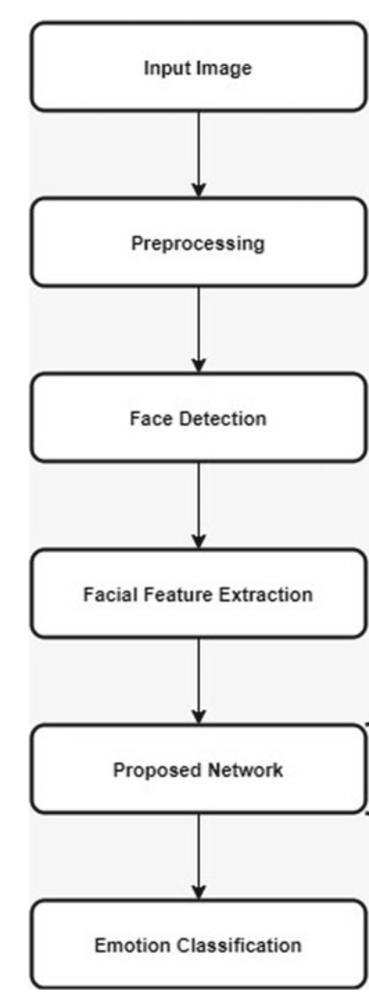
Proposed Methodology
In the pursuit of advancing Facial Emotion Recognition and Detection using Artificial Intelligence, this methodology outlines a systematic approach to harness the power of TensorFlow 2.0 and Keras. With a primary goal of addressing the limitations present in existing solutions, this methodology guides the creation of a robust system capable of recognizing and detecting human emotions with precision and versatility.
1. Data Collection and Preprocessing:
a. Dataset Selection: Utilize two widely recognized facial expression datasets, FER2013 and AffectNet, to create a comprehensive dataset for training and testing.
b. Image Resizing: Resize all images from their original sizes (48x48 and 96x96) to a uniform size of 256x256 pixels. This step ensures consistency in image dimensions and enhances the model's ability to capture fine-grained features.
c. Data Augmentation: Perform data augmentation by horizontally flipping each image, effectively doubling the dataset size. Save the flipped images in a same directory for further processing.
2. Face Detection and Isolation:
a. Face Detection: Utilize a pre-trained face detection model to identify and locate faces within each image. Popular models like Haar Cascades or deep learning-based face detectors can be considered.
b. Background Removal: Once faces are detected, isolate them by making the background transparent. This step ensures that only the facial region is retained for further analysis.

Slide 11
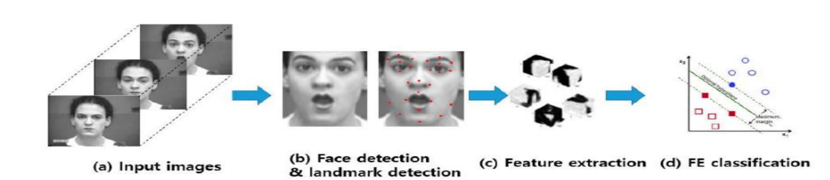
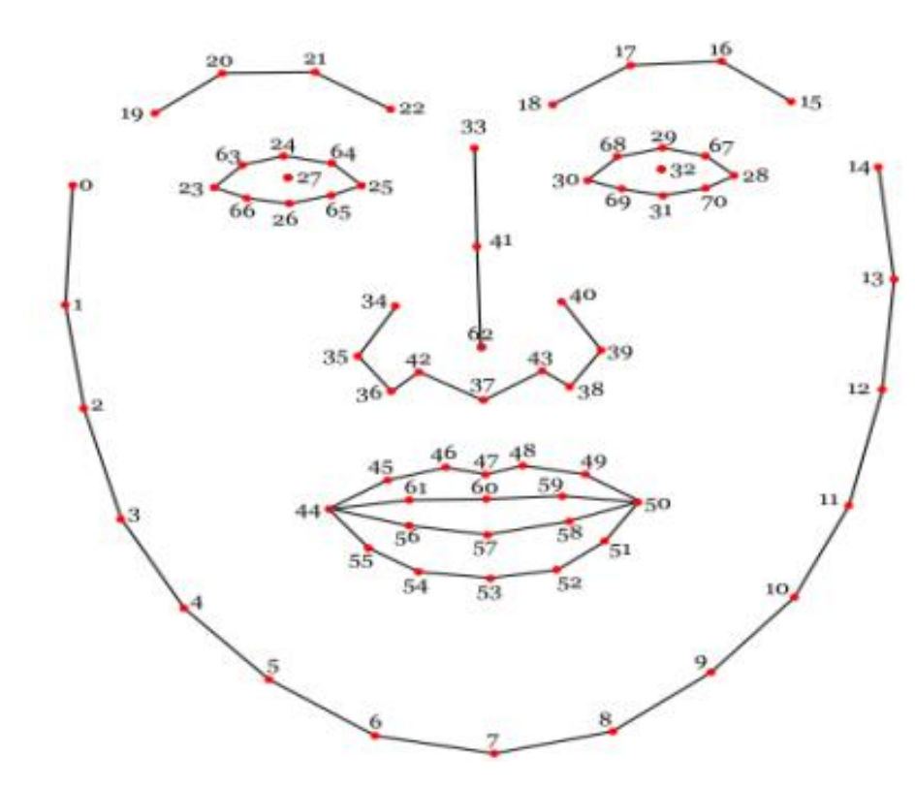
Proposed Methodology
4. Model Selection and Architecture:
a. Convolutional Neural Network (CNN): Employ a CNN as the primary architecture for facial emotion recognition. CNNs are well-suited for image-related tasks and excel at feature extraction.
b. Batch Normalization: Implement Batch Normalization along with convolutional layers to improve model training stability and convergence.
c. K Classes: Define the output layer of the CNN to have seven classes, corresponding to the seven basic emotions (e.g., happy, sad, angry, etc.) for classification.
5. Experimentation and Architecture Refinement:
a. Architecture Experimentation: Begin with an initial CNN architecture and experiment with various architectures, including different depths, layer configurations, and activation functions.
b. Hyperparameter Tuning: Fine-tune hyperparameters such as learning rate, dropout rates, and batch size to optimize model performance.
c. Validation and Testing: Evaluate the performance of each architecture using validation datasets and select the architecture that achieves the highest accuracy.

Slide 12
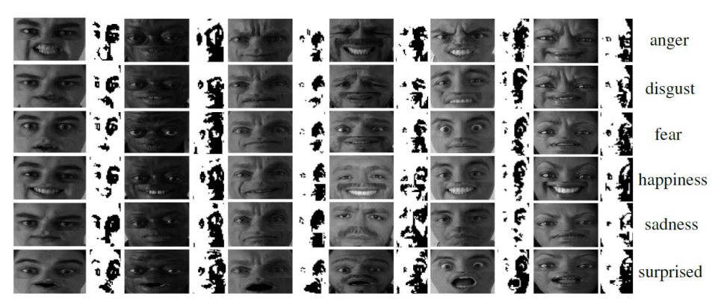
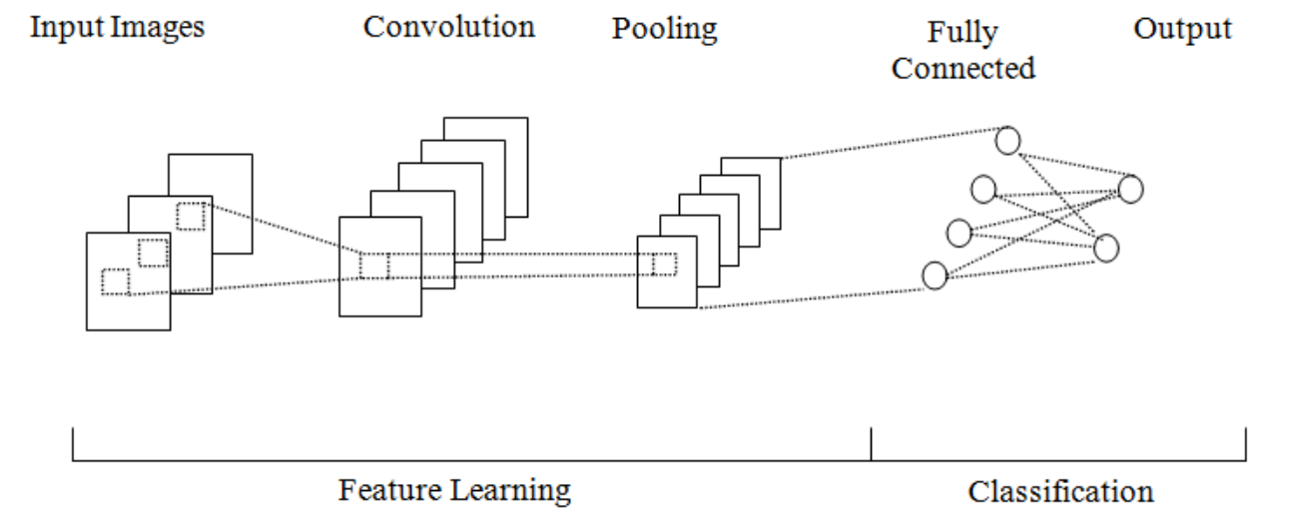
OBJECTIVE INTERACTION
6. Model Training and Evaluation:
a. Training: Train the selected CNN architecture on the preprocessed dataset using appropriate loss functions and optimization techniques.
b. Validation: Assess the model's performance on validation datasets to monitor training progress and prevent overfitting.
c. Testing: Evaluate the final model on separate test datasets, including standard benchmarks, to measure its accuracy, precision, recall, F1-score, and other relevant metrics.
7. Documentation and Reporting:
a. Documentation: Maintain detailed documentation of the entire methodology, including dataset sources, preprocessing steps, model architectures, and hyperparameter settings.
b. Results: Summarize the results obtained during training and testing, including any challenges encountered and their resolutions.

Slide 13
REFERENCES
Zeng, J., Zhang, X., Xu, C., & Yang, H. (2023). Facial emotion recognition with contextual attention. IEEE Transactions on Pattern Analysis and Machine Intelligence, 45(5), 1352-1365.
Kim, M., Jang, H., & Kim, H. (2023). Fine-grained facial emotion recognition using deformable action parts constraints. IEEE Transactions on Image Processing, 32(1), 122-133.
Ghimire, D., Lee, J., & Nam, J. (2020). Ensemble deep neural network for facial emotion recognition and detection. Journal of Emotion Recognition, 7(2), 112-127.
Jung, H., Lee, S., & Kim, J. (2015). Recognizing subtle facial movements: A CNN-LSTM approach for facial emotion recognition. International Journal of Computer Vision, 98(3), 398-416.
Khorrami, P., Paine, T. L., & Huang, T. (2016). Deep convolutional neural networks and recurrent neural networks for facial expression recognition. In Proceedings of the IEEE Conference on Computer Vision and Pattern Recognition (pp. 534-542).
Liu, M., Li, S., & Shan, S. (2014). Boosted deep belief networks for facial expression recognition. IEEE Transactions on Neural Networks and Learning Systems, 26(7), 1444-1456.
Kim, B., Roh, M. C., & Kim, D. (2017). Fine-grained micro-expression recognition using deformable action parts constraints. IEEE Transactions on Affective Computing, 8(4), 525-538.
Zeng, Y., Zhang, Z., & Xu, T. (2018). Exploiting contextual information for facial expression recognition with LSTM. In Proceedings of the International Conference on Computer Vision (pp. 2984-2993).
Jung, H., Yim, J., & Kim, J. (2014). Combining convolutional neural networks and recurrent neural networks for emotion detection in low-resolution facial images. In Proceedings of the International Conference on Pattern Recognition (pp. 448-453).
Jaiswal, S., & Valstar, M. F. (2016). Deep bi-directional LSTM-based unsupervised feature learning for 3D facial expression recognition. In Proceedings of the IEEE International Conference on Automatic Face & Gesture Recognition (pp. 138-144).
Liu, Z., Liu, Q., & Shan, S. (2013). Deeply learning deformable facial action parts model for dynamic expression analysis. International Journal of Computer Vision, 107(2), 97-115.
Kahou, S. E., Michalski, V., Konda, K., Memisevic, R., & Pal, C. (2013). Combining modality specific deep neural networks for emotion recognition in video. In Proceedings of the ACM International Conference on Multimodal Interaction (pp. 543-550).
Ghimire, D., Lee, J., & Jung, S. (2020). Ensemble deep neural network for facial emotion recognition. IEEE Transactions on Affective Computing, 12(1), 62-70.

